Slide 1

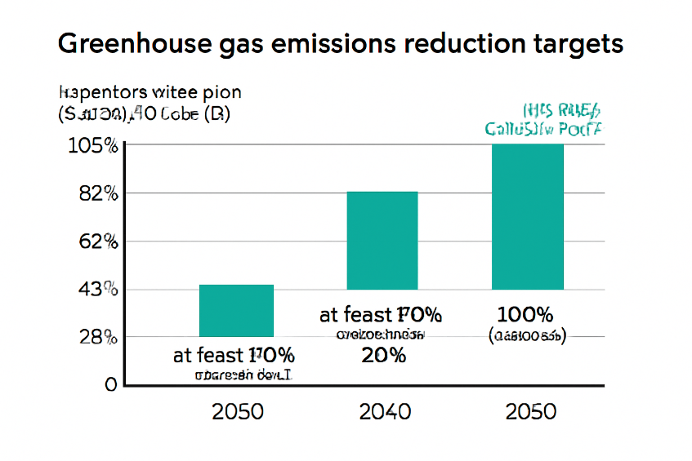
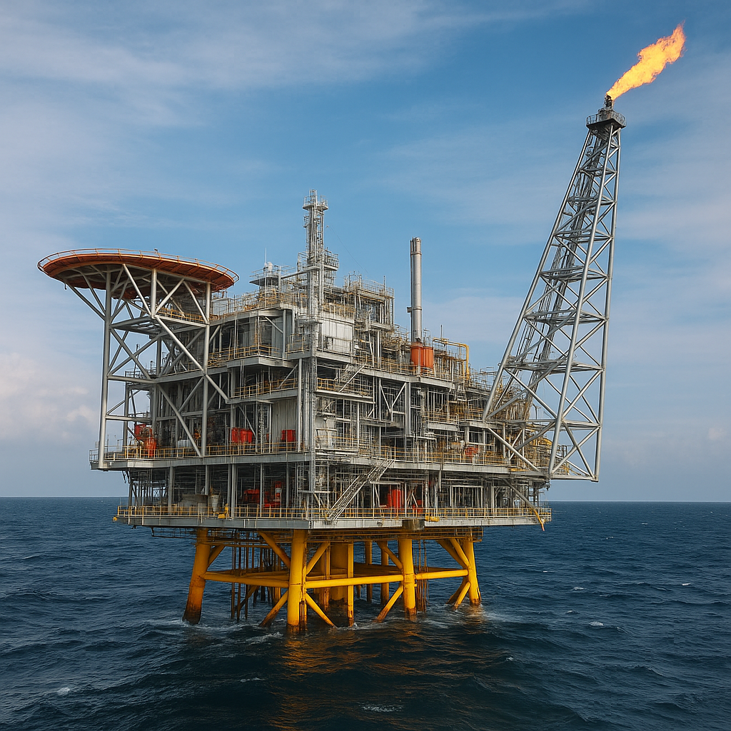
(قلم B Titr Bold و سايز 28pt)
Guidelines for Poster Paper Preparation Article title in one or two lines, in bold Times New Roman, size 54
Authors’ Names, Email address of the 1st author
Abstract .
This paper aims to
Introduction .
1- Poster is in A1 size, portrait orientation (84.1 × 59.4 cm).
2- All main sections of the paper must be fully included in the poster in the following order:
Article title
Full names of the authors
Main text of the article including: – Introduction – Main body – Results and discussion – Conclusion References (maximum 5 items).
3- The poster must be prepared on a single page and according to the specified format; other templates or formats will not be accepted.
4- The poster must be uploaded in PPTX and PDF formats with a maximum file size of 20 MB.
5- The presenter must be a registered conference participant and be present next to his poster during the poster presentation session.
Methods and relations .
Absolute
Bbbbbb
Cccccc
Fig. 1: (a) Greenhouse gas emissions chart; (b) offshore platform and related safety.
Table 1: Comparison of Maritime Standards
Font type and size .
Font type: Times New Roman
Size:
Paper Title: 54
Authors’ Names: 34
Headings: 28
Text: 24
Results and Discussion .
Absolute
Bbbbbb
Cccccc
Conclusion .
Absolute
Bbbbbb
Cccccc
References .
[1] IMO, SOLAS Convention, 2020.
[2] IACS Unified Requirements, 2021.
[3] ISO 19900, Offshore Structures, 2019.
[4] Paik & Thayamballi, Ship-Shaped Offshore Installations, 2007.
[5] DNV Offshore Standards, 2021.
Standard | Details | Safety | Security
IMO | IMO | IMO | IMO
ISO | ISO | ISO | ISO

